Slide 1

How Machine Learning is Transforming Article Recommendations
?

Slide 2
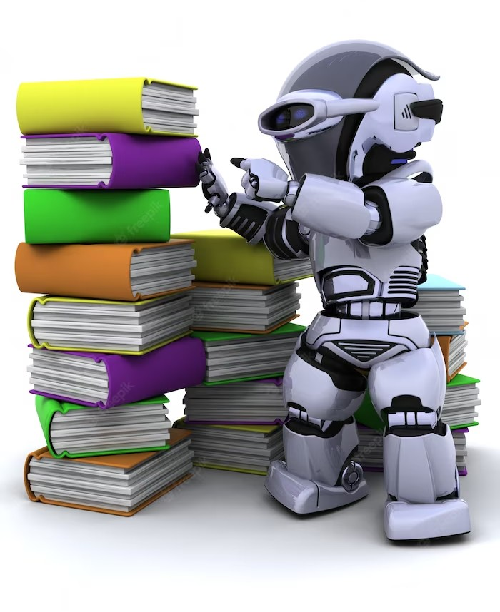
Revolutionizing Reading
Discover how machine learning is transforming the reading experience. Explore the future of article recommendations.

Slide 3


What is Machine Learning?
Machine learning is a subset of Artiﬁcial Intelligence that involves training algorithms to learn patterns from data.

Slide 4


How Machine Learning Works
Machines learn by processing large amounts of data, identifying patterns, and predicting outcomes. Learn how this applies to article recommendations.

Slide 5

ARTICLE RECOMMENDATIONS SYSTEM USING MACHINE LEARNING
An AI-powered article recommendation system is an excellent way to enhance user experience by providing personalized article suggestions based on their behavior and preferences. Prioritizing user privacy and transparency is crucial when implementing such a system to ensure that users feel conﬁdent and secure in their interactions with the platform.

Slide 6
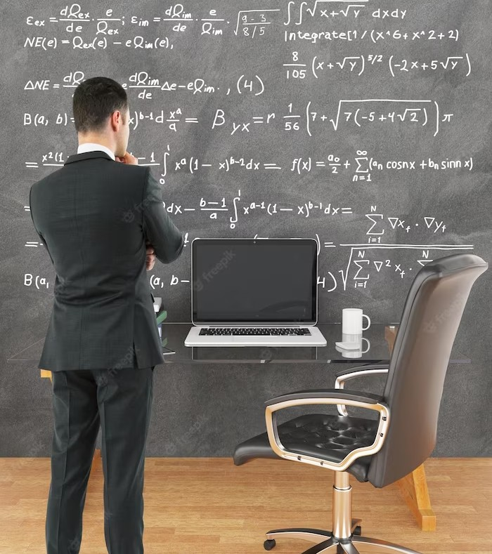
Power of Cosine Similarity: Article Recommendation Systems
Cosine similarity is a nifty tool that helps us determine how similar two vectors are in an inner product space.
It's widely used in information retrieval, data mining, and machine learning. The value ranges from -1 to 1, with 1 indicating identical vectors and 0 indicating orthogonal vectors. It's a
crucial component for search engines and recommendation systems. By calculating cosine similarity, we can make informed decisions on how similar two vectors are. It's a handy- dandy tool for working with high-
dimensional data.

Slide 7
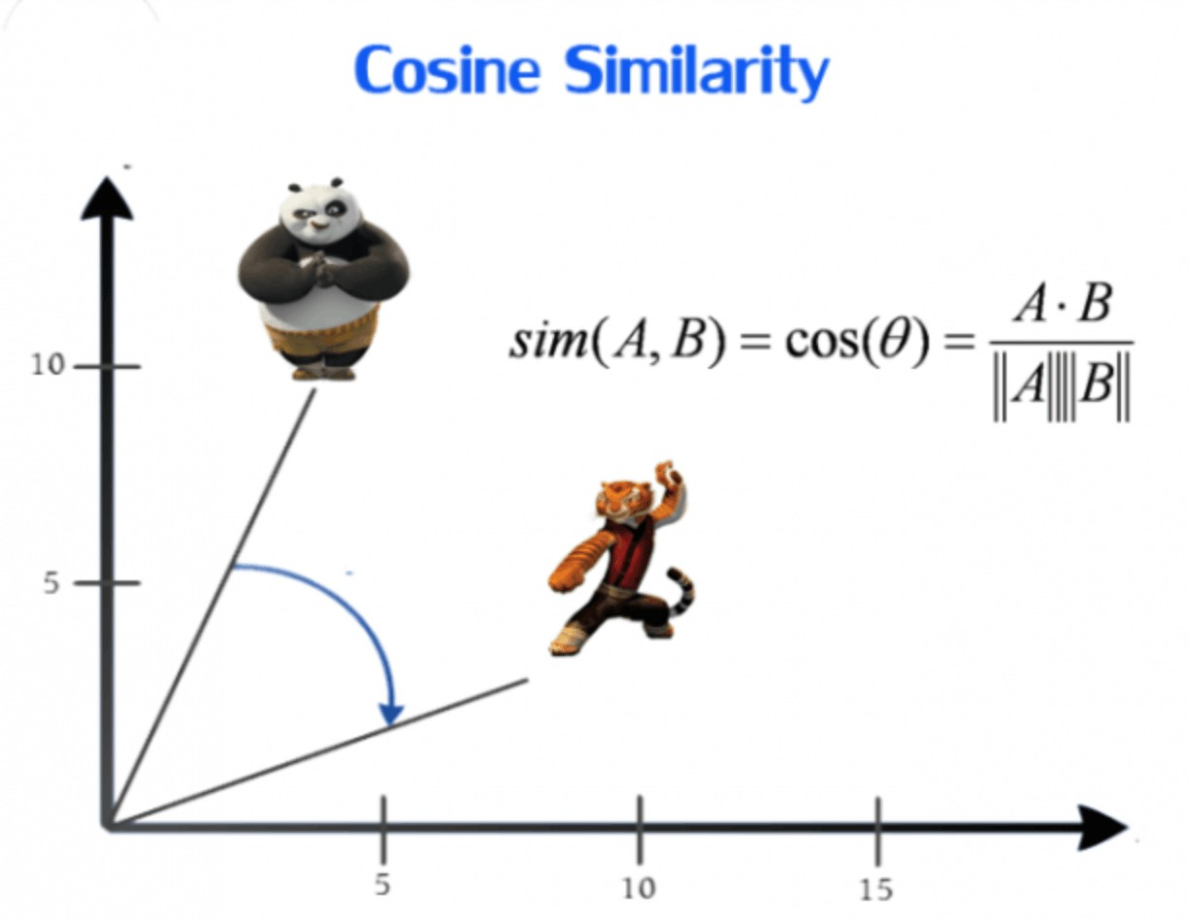
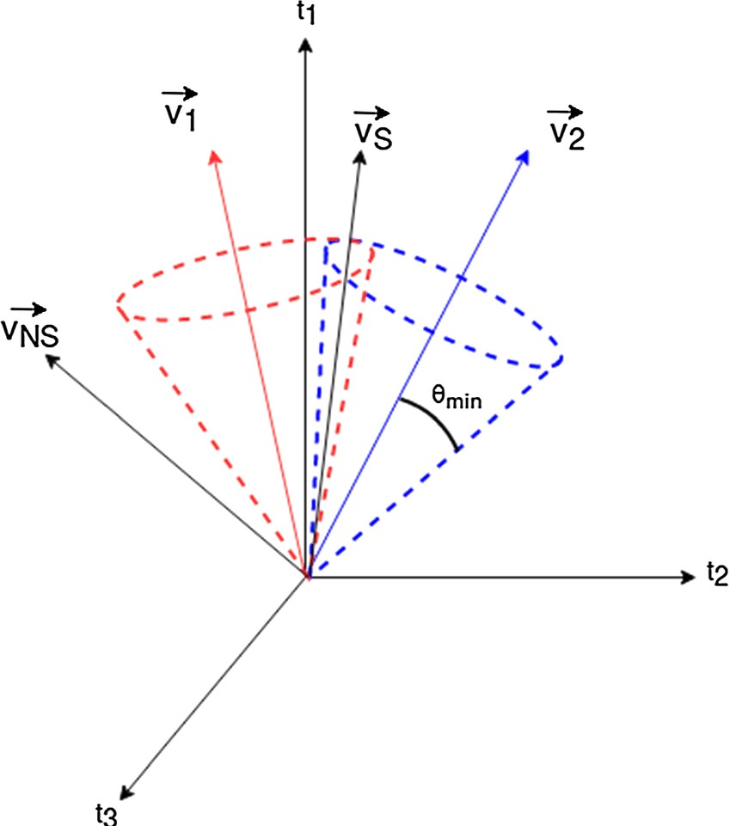

Slide 8
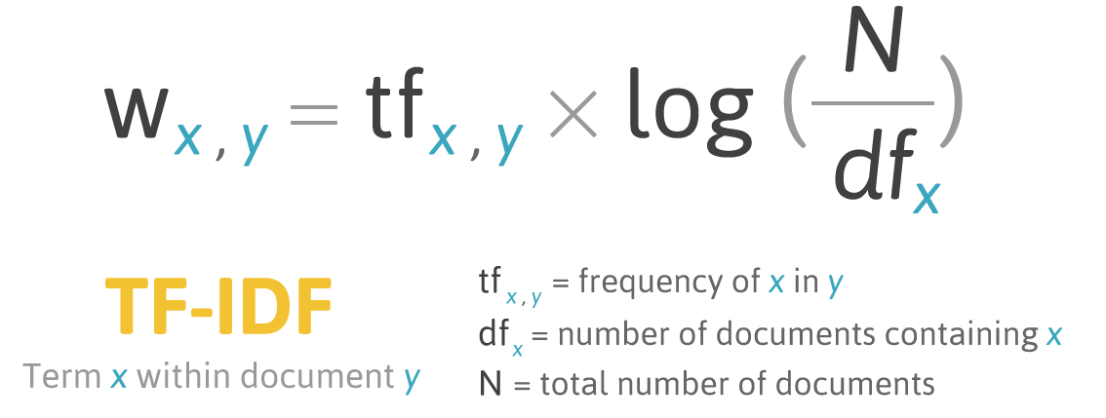
Tﬁdf Vectorizer
Tﬁdf Vectorizer is a widely used tool for extracting textual features from data, offered by SciPy. Its primary function is to convert text into numerical feature vectors by computing TF- IDF. This results in efficient text classiﬁcation and clustering, with added options for preprocessing, tokenization, and stop word ﬁltering.

Slide 9

Tools used in article recommendation systems
There are several tools used in article recommendation systems, including natural language processing (NLP), machine learning algorithms, and data analytics. NLP is used to extract meaningful information from text, while machine learning algorithms are used to make predictions based on that information.
Data analytics is used to analyze user behavior and preferences, which can then be used to personalize recommendations. These tools work together to create a system that can recommend articles that are relevant to each individual user.

Slide 10

The Future of Reading
With machine learning, the reading experience will continue to evolve and become more personalized. Join the revolution and transform your reading experience!

Slide 11
Conclusion
Machine learning is transforming the way we read and interact with content. Embrace the revolution and discover the power of personalized article recommendations.

Slide 12
Thank you!

